Slide 1

SMART SPL
AUTOMATION SYSTEM

Slide 2
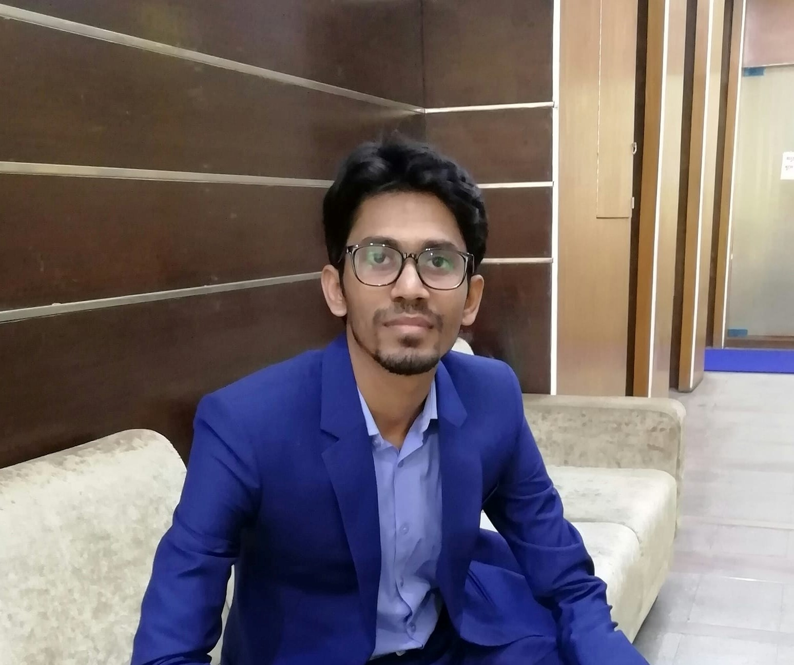
OUR MENTOR
Md. Hasan Imam
Lecturer, IIT
Noakhali Science And Technology University

Slide 3

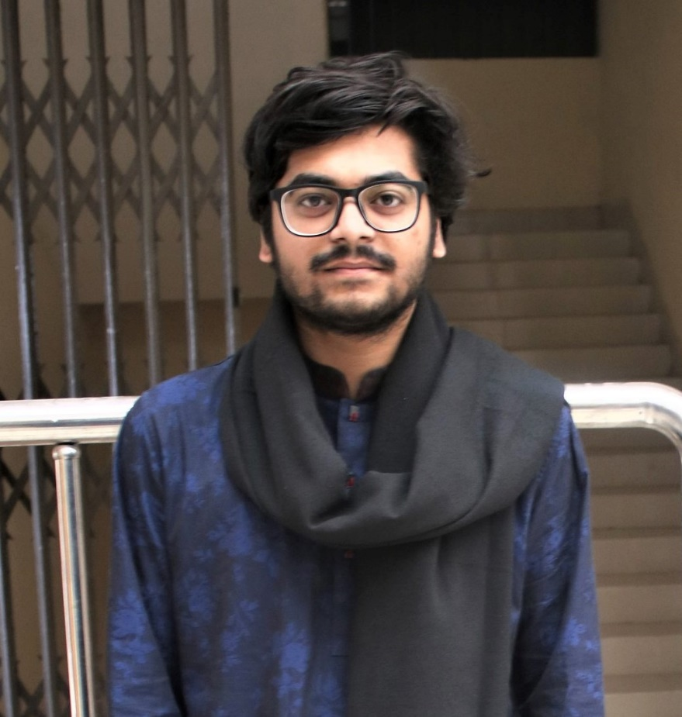
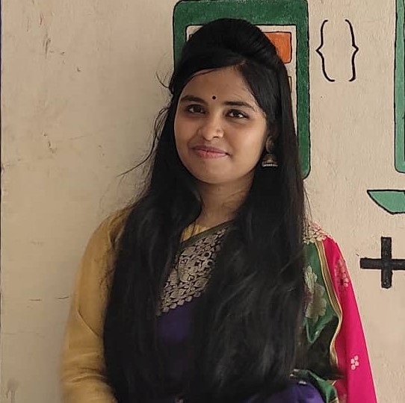
TEAM MEMBER
MEET OUR TEAM MEMBERS
Sunaan Sultan
ASH1925004M
sunaan2514@student.nstu.edu.bd
Md. Rayhan Billah
Ayesha Nasrin Ripa
ASH1925028M
BKH1925025F
rayhan2514@student.nstu.edu.bd
ayesha2514@student.nstu.edu.bd

Slide 4
Covered Today
A brief outline
Introduction
Motivation
Purpose
Functional requirements
Non Functional requirements
contribution
User Interface
Tools used
Limitations
Challenges Faced
Future work

Slide 5


Introduction
A web application for Software Project Lab. The SPL course protocols are contained and applied here. Using this program, teachers and students will be able to automate various SPL operations.

Slide 6

MOTIVATION BEHIND CHOOSING THIS PROJECT

Slide 7
Purpose of Smart SPL Automation System
Automate the Software project lab course
Automate the process of writing reports
Create team in an automated procedure

Slide 8

Functional requirements
Sign Up
Log in
Create Room
Create Project
Create Team
Report generator
Create task

Slide 9
Non Functional requirements
Performance Requirements
Speed and Latency Requirements
Reliability and Availability
A specification of a performance attribute that a system, or system component must have, such as speed, precision, or frequency.
The landing page will appear within a second while the user is surfing the system.
It also relies on the internet connection of the user.
The system must be available 24 hours in a day.
The system must be updated occasionally

Slide 10
Contribution
 |  | Members | Sunaan | Rayhan | Ayesha
Coding | Sign up, Login, Create Room, Create Task, Create Project, create team, categorize student, Task name, description, due date, add attachments, set priority, Report Generator | Front-End | 50% | 30% | 20%
 |  | Back-End | 30% | 50% | 20%
System Integration |  |  | 35% | 35% | 30%
Testing and debugging |  |  | 35% | 35% | 30%
Slide Preparation |  |  | 50% | 25% | 25%
Demo presentation |  |  | 40% | 40% | 20%

Slide 11
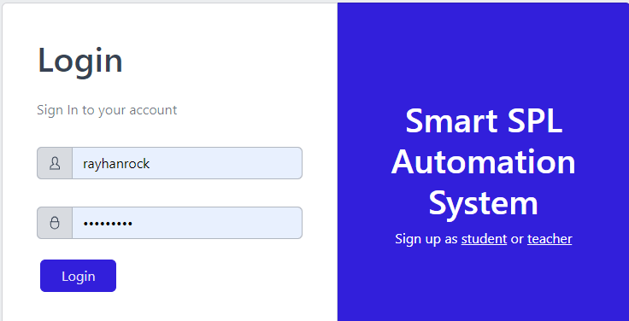
USER INTERFACE

Slide 12
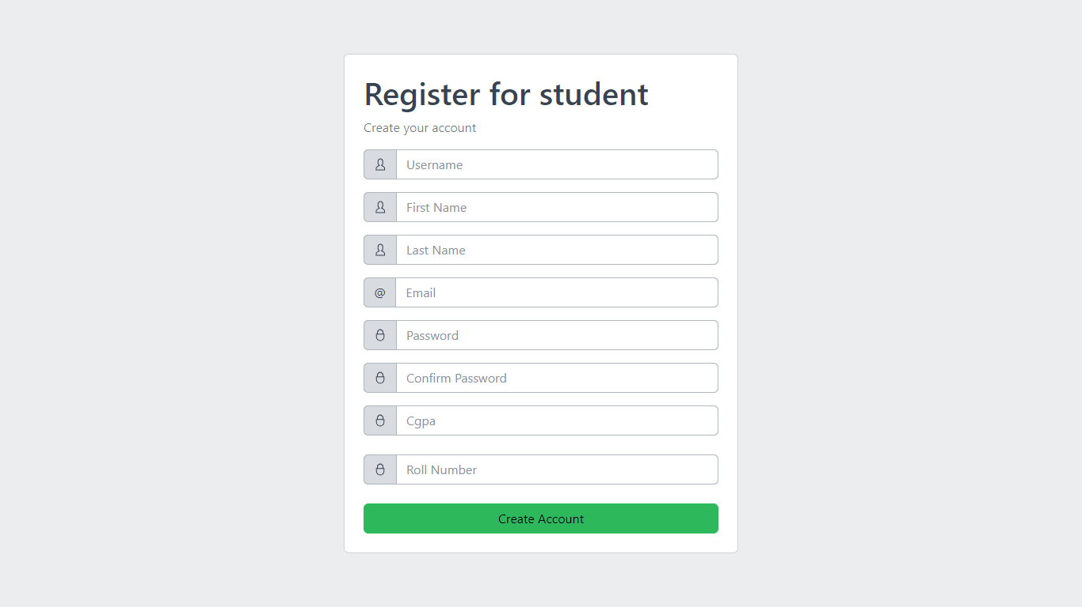
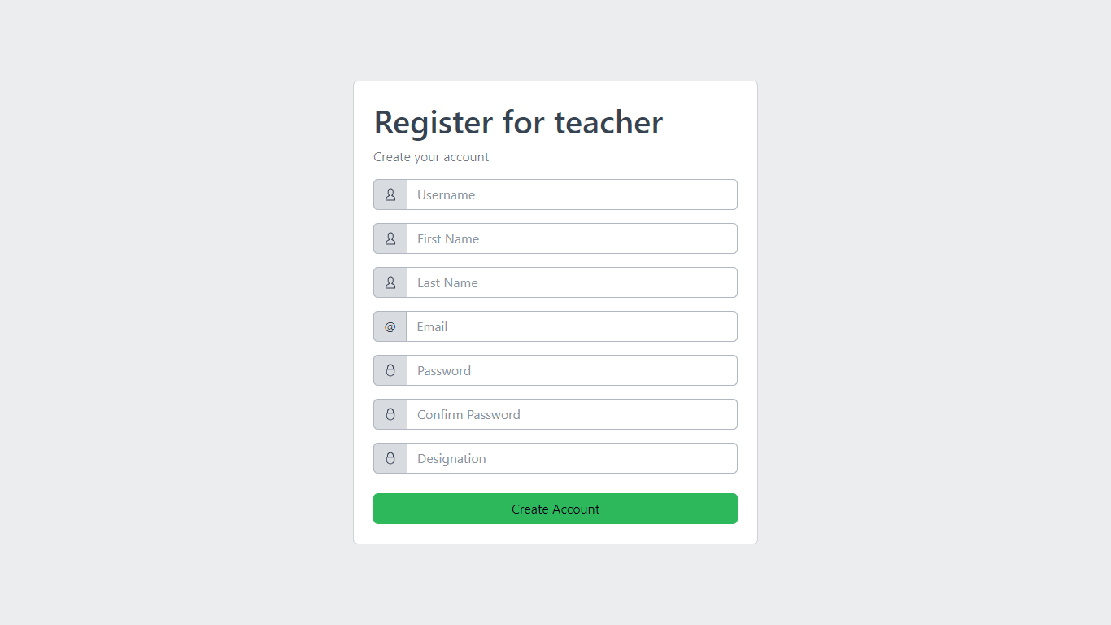
USER INTERFACE

Slide 13
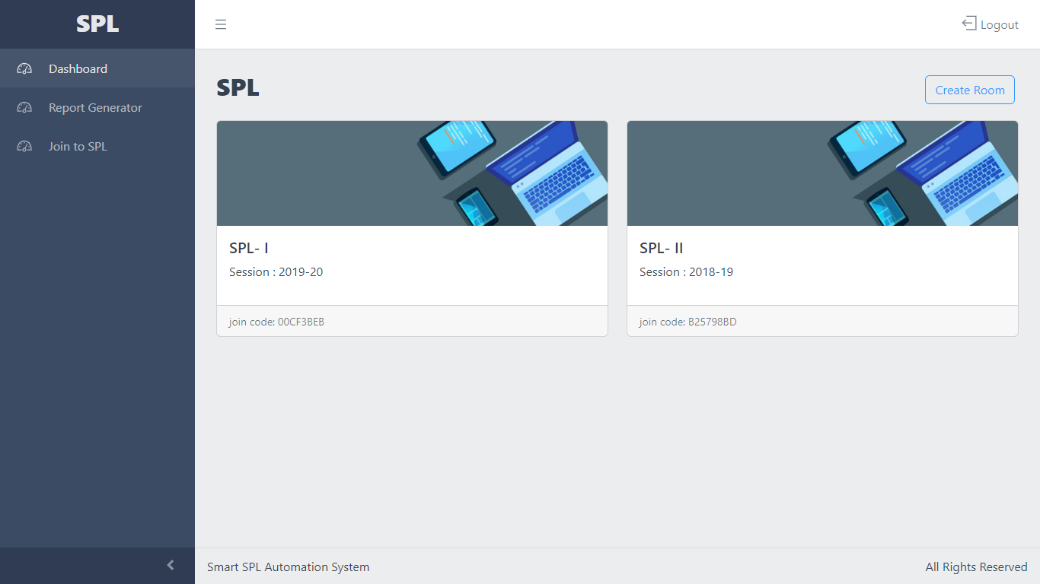
The dashboard will be designed with a colorful interface and intuitive layout for easy navigation that will help users create and navigate to their respective rooms. Also using the side panel users will be able to visit other tabs.

Slide 14
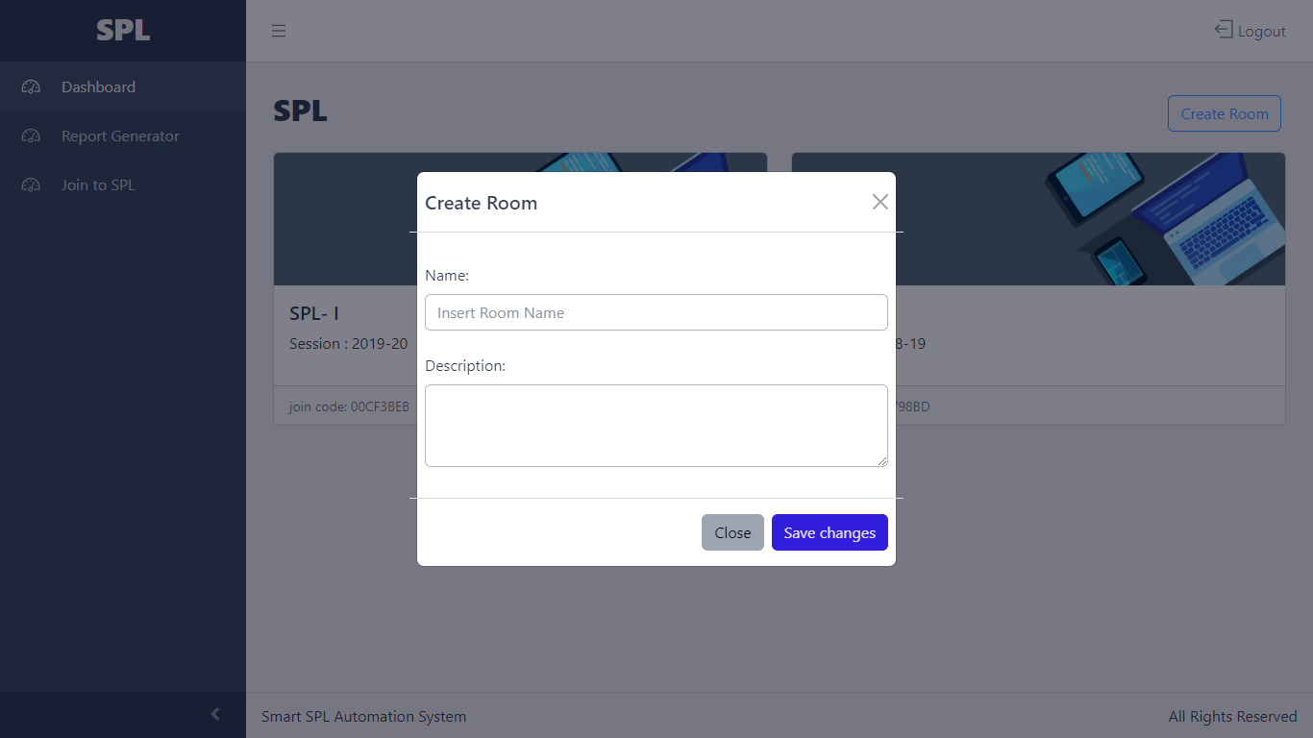
We can create room by giving room name and description

Slide 15
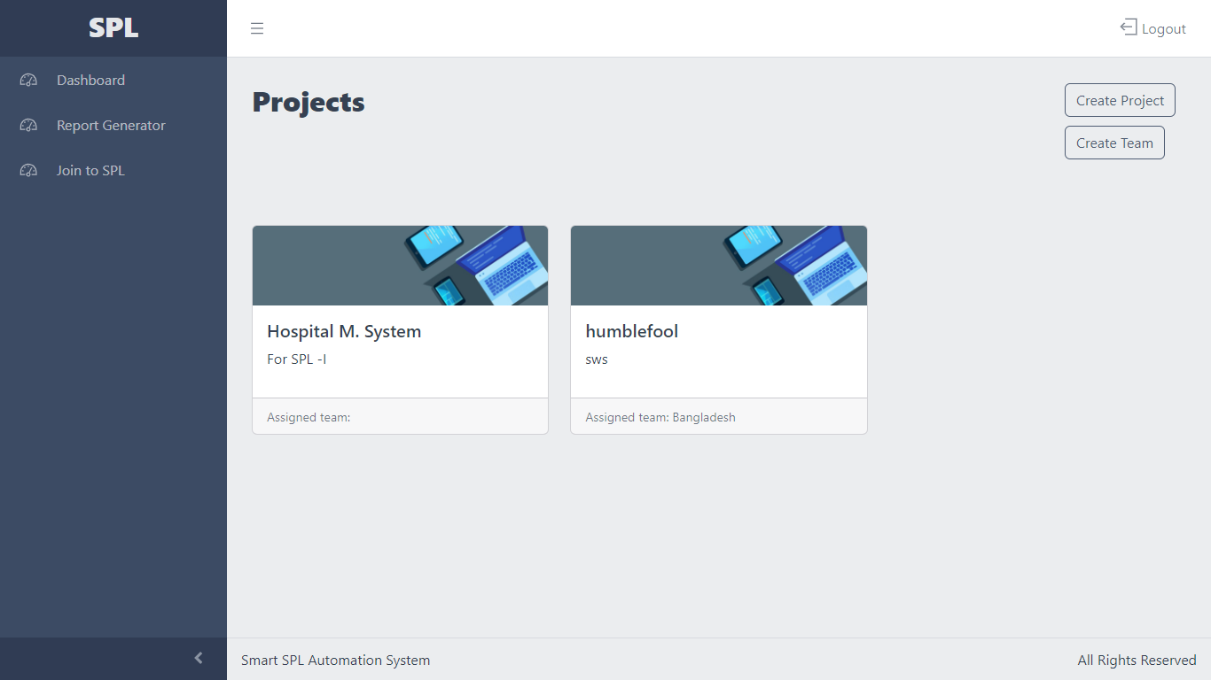
Projects menu

Slide 16
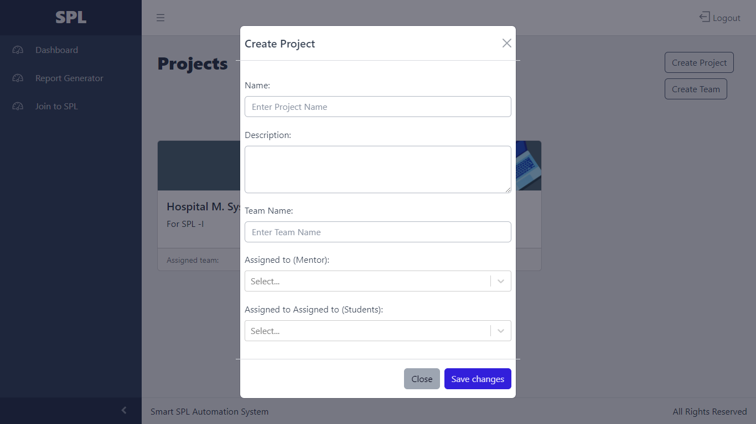
Inside the rooms teachers will be able to create projects add & assign tasks and students will be able see those respective tasks and work accordingly.

Slide 17
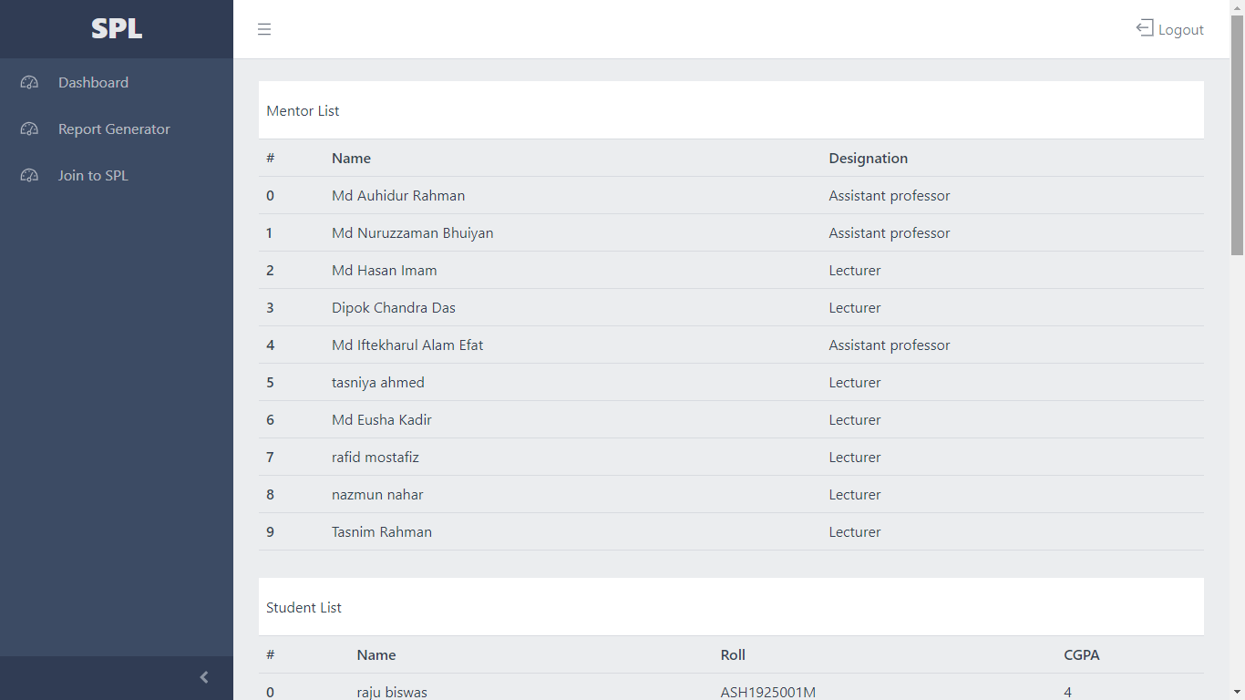
To view the mentor and student list, click the "Create Team" option.

Slide 18
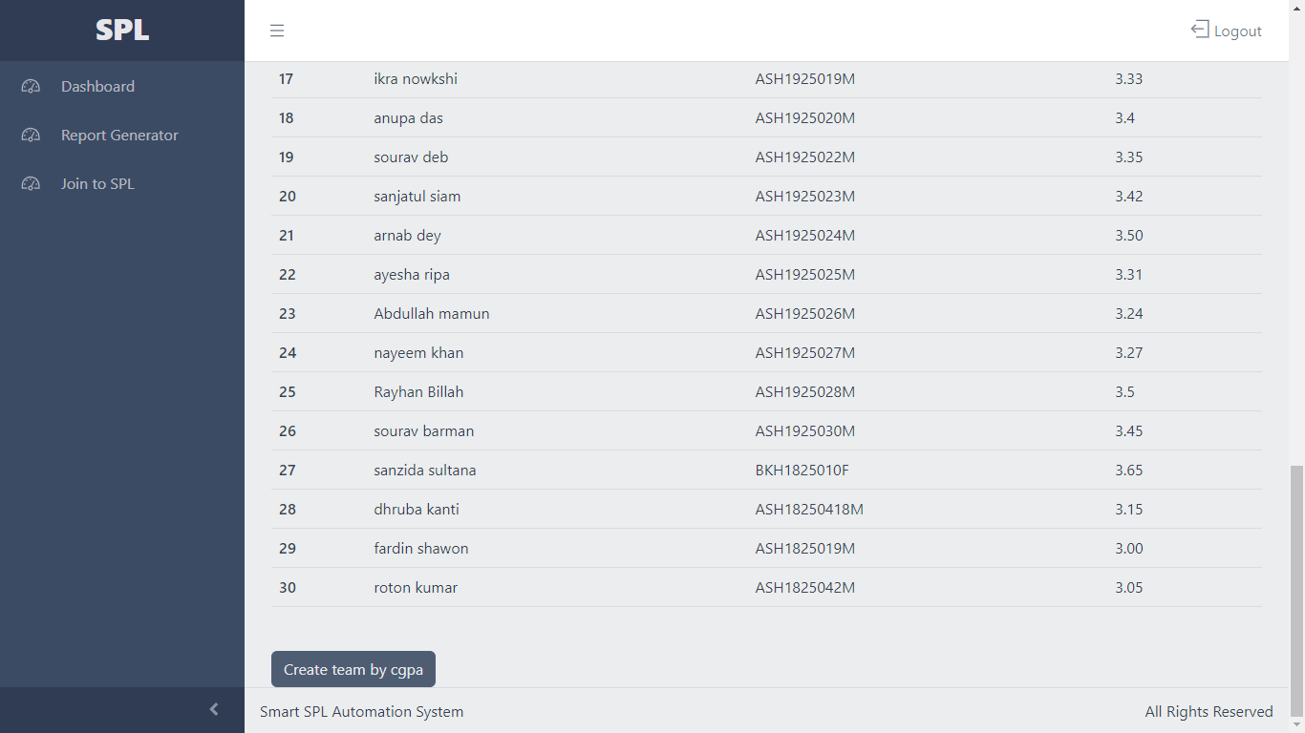
After creating the list, click the "create team by gpa" option to create teams.

Slide 19
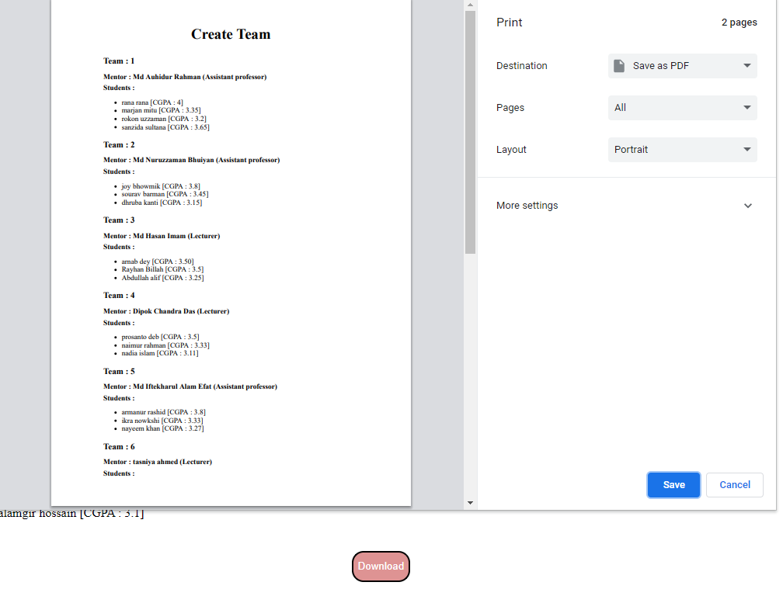
Click save to save as PDF.

Slide 20
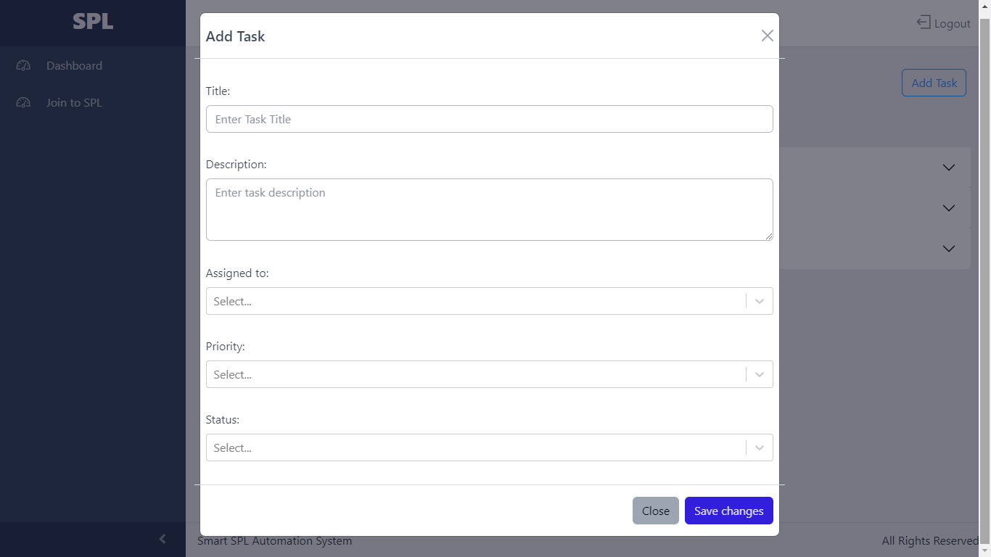
Add task section

Slide 21
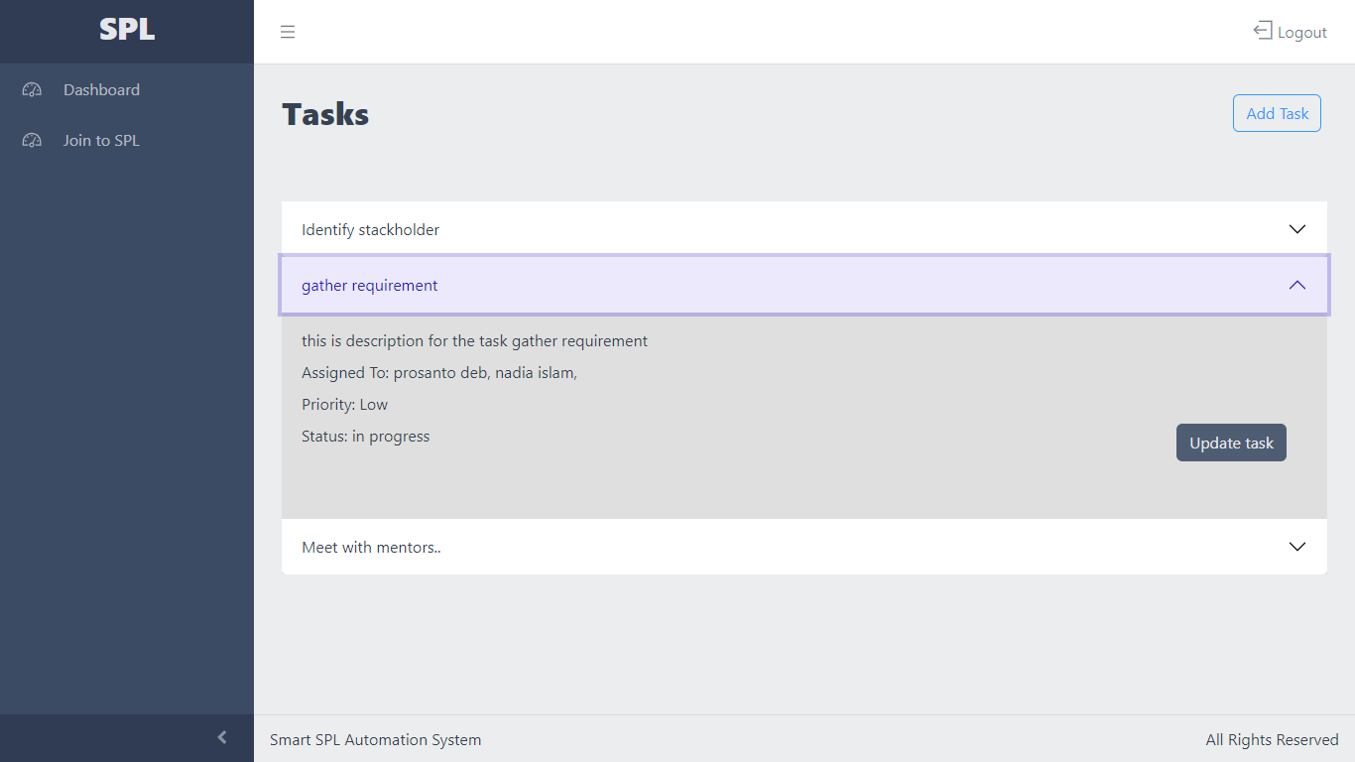
List of tasks

Slide 22
TOOLS AND LANGUAGES USED
VISUAL STUDIO CODE
JAVASCRIPT
REACT-JS
HTML
CSS
BOOTSTRAP
PYTHON
DJANGO

Slide 23

LIMITATIONS
Learning new technologies.
Coding in a structured way.
Data collection.

Slide 24
CHALLENGES FACED
Completing the project within proposed time and meet the deadline
Working with new technology
Defining the requirements of the software development project.
Planning the project modules and functionality.

Slide 25

FUTURE WORK
Add Post notice and announcements
Add Chatting and SMS option

Slide 26



THANK YOU

